Slide 1
ICT & Software Engineering
11 – Classes & Objects
Class design

Slide 2

Content
Topics of this lecture
General feedback
Final individual assignment
Creating a class design
Q&A

Slide 3

General feedback

Slide 4
Final Individual Assignment
Final submission to show your proficiency

Slide 5

Intro
Only four weeks remaining!
Final individual assignment in Canvas:
Week 15, 16 & 17 – Part 2 & 3: Work on the assignment
Week 18: feedback about submission
Purpose: final chance to show that your proficiency level is indeed proficient or advanced!

Slide 6
Intro
Final individual assignment != no lectures
Week 15, 16 & 17 – part 1: How to make a class design
How to apply the concepts you learned to solve a problem
Based on a case during Classes and Objects lecture
Based on data during Windows Forms lecture
Additional practice for the final individual assignment
Preparations for next semester

Slide 7
From problem to a solution
Determine business requirements
Translate business requirements to a model
Transform a model into a class diagram
Implement class diagram
Test implementation

Slide 8

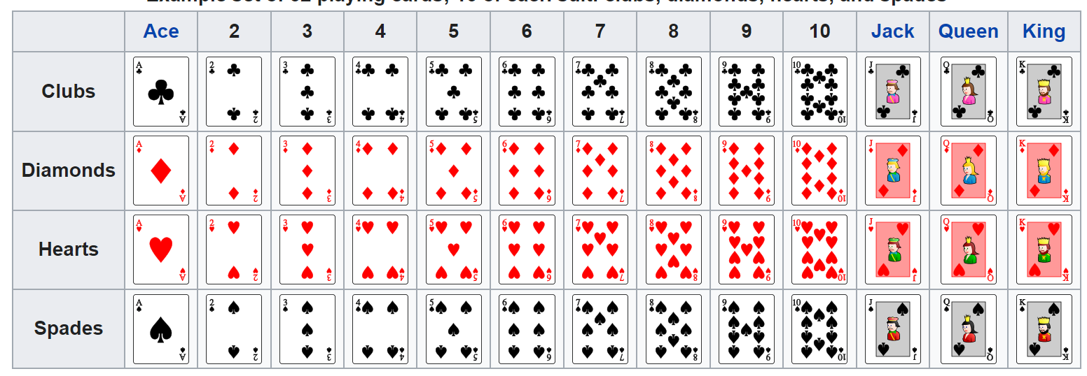
Practice: Card game
We want to build an application for simple card game for three players. A deck of cards (52 cards) is randomly divided between the number of players so that everyone will end-up the same amount of cards (e.g. when there are 3 player each player gets 17 cards and 1 card will be remaining). Any remaining will be shown to all players.
During each round, players should select one of the card in their hand, and the player with the highest card wins the round; this continues till are cards are player. The goal of the game is to win the most rounds and which card is the highest is as following:
Lowest
Highest

Slide 9
Practice: Card game – Step 1
We want to build an application for simple card game for three players. A deck of cards (52 cards) is randomly divided between the number of players so that everyone will end-up the same amount of cards (e.g. when there are 3 player each player gets 17 cards and 1 card will be remaining). Any remaining will be shown to all players.
During each round, players should select one of the card in their hand, and the player with the highest card wins the round; this continues till are cards are played. The goal of the game is to win the most rounds and which card is the highest is as following:
Lowest
Determine business requirements
Highest

Slide 10
Practice: Card game – Step 1
We want to build an application for simple card game for three players. A deck of cards (52 cards) is randomly divided between the number of players so that everyone will end-up the same amount of cards (e.g. when there are 3 player each player gets 17 cards and 1 card will be remaining). Any remaining will be shown to all players.
During each round, players should select one of the card in their hand, and the player with the highest card wins the round; this continues till are cards are played. The goal of the game is to win the most rounds and which card is the highest is as following:
Lowest
Determine business requirements
Highest

Slide 11
Practice: Card game – Step 2
Translate business requirements to a model
????
????
????

Slide 12
Practice: Card game – Step 2
Translate business requirements to a model
Game
Player
Card
Round

Slide 13
Practice: Card game – Step 3.1
Transform a model into a class diagram
????
????
?
????

Slide 14
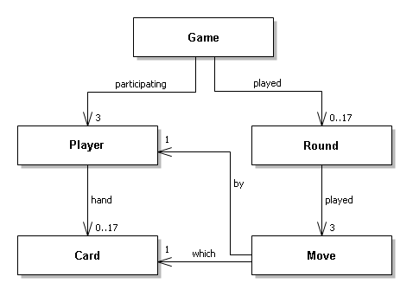
Practice: Card game – Step 3.1
Transform a model into a class diagram

Slide 15
Practice: Card game – Step 3.2
Transform a model into a class diagram
????
????
????
?
????
????
????
????

Slide 16
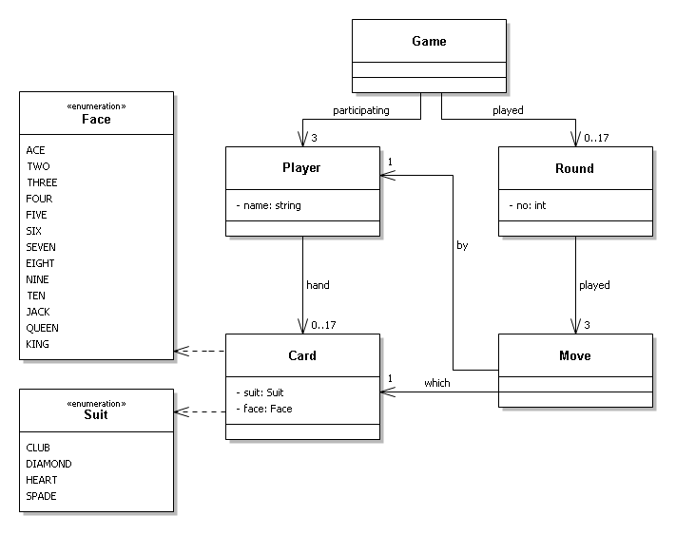
Practice: Card game – Step 3.2
Transform a model into a class diagram

Slide 17
Practice: Card game – Step 3.3
Transform a model into a class diagram
????
????
????
????
?
????
????
????
????
????

Slide 18
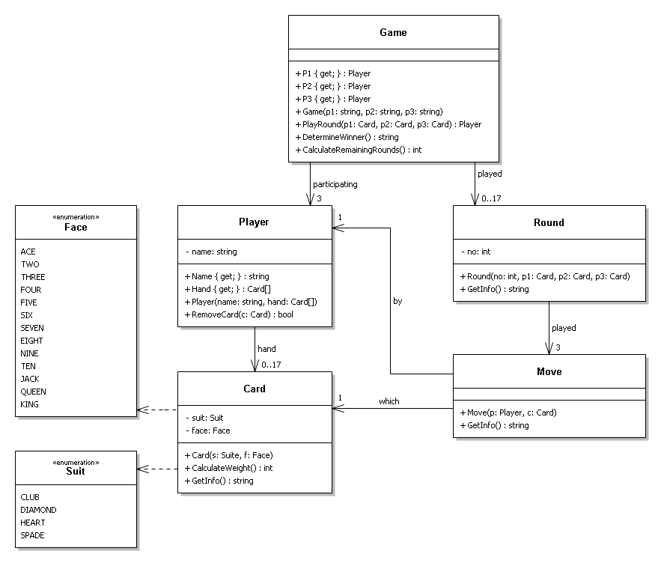
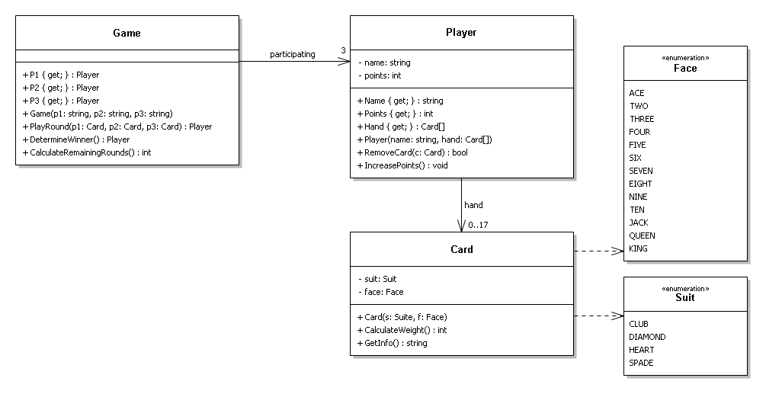
Practice: Card game – Step 3.3

Slide 19

Questions?

Slide 20

What to do next?
Try to implement the created class design as practice
Start working on the final individual assignment you got assigned

Slide 21
Part2 - Practical
Work on the final individual assignment

Slide 22
Part 3
Q&A

Slide 23
Content
Topics of this lecture
General feedback
Final individual assignment
Creating a class design
Q&A

Slide 24
Questions?

Slide 25

Summary
After this lecture you can:
You are aware of how to design a class diagram

